Slide 1
Progress Presentation
Symmetric algorithm modification system
Supervisor : Mr. Kavinga Yapa Abeyawardena
Co-supervisor : Mr. Nuwan Kuruwitarachchi

Slide 2
Team members
IT14120930 – K.P.A.P Pathirana
IT14100376 – N.H.A.D.A Hangawaththa
IT14116216 – L.R.M.O Lankarathne

Slide 3
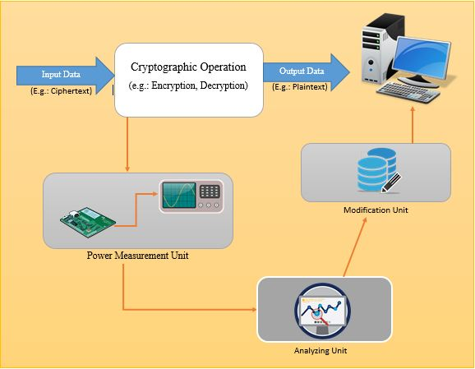
Overall IDEA

Slide 4
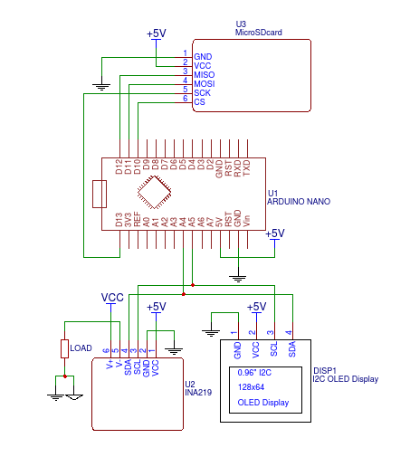
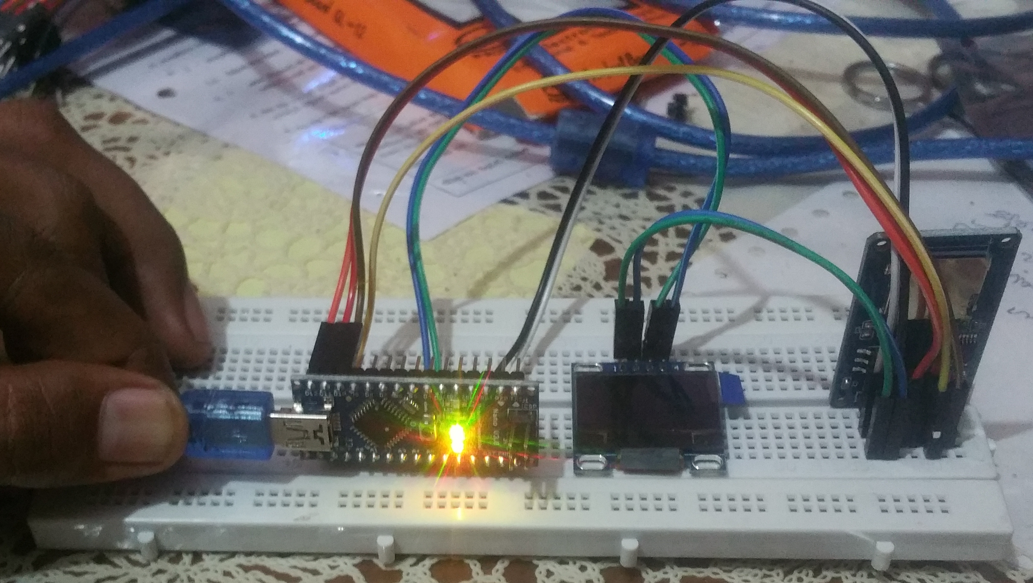
Power measurement unit

Slide 5
INA219 I2C Bi-directional DC Current Power Supply Sensor – This sensor is use to get the current, voltage and time values.
0.96" I2C IIC SPI Serial 128X64 White OLED LCD – This will display the values in real time .
TF Card Memory Shield Module – The data that will gather with INA219 and arduino will be recorded in to an SD card as data sets in text files.
Arduino Nano – All the modules will be managed and necessary coding will be done on the Arduino.

Slide 6
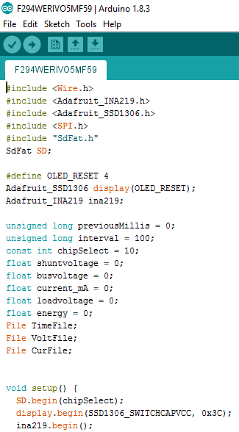
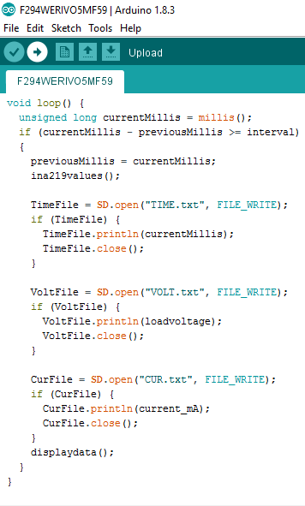
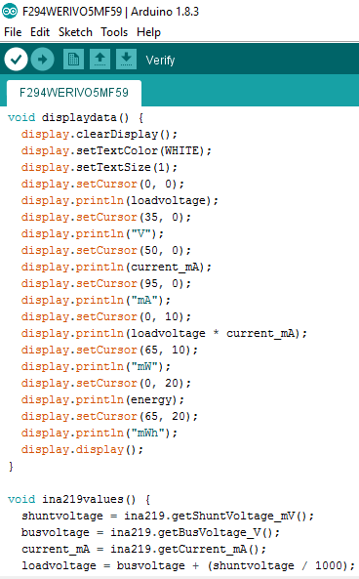

Slide 7
Analyzing Unit

Slide 8
Modification Unit
Main steps of the
Import algorithm into the system.
Identify the language, that algorithm has written.
Generate the random code segment.
Insert the random code into the algorithm and save it.

